Slide 1


Slide 2

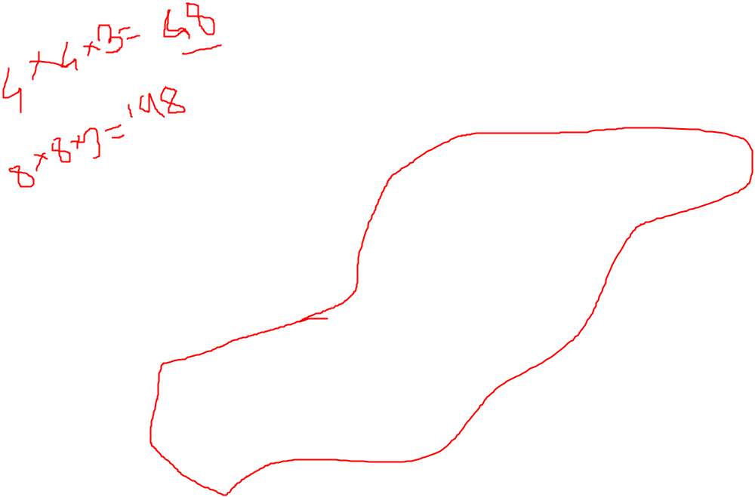


Slide 3
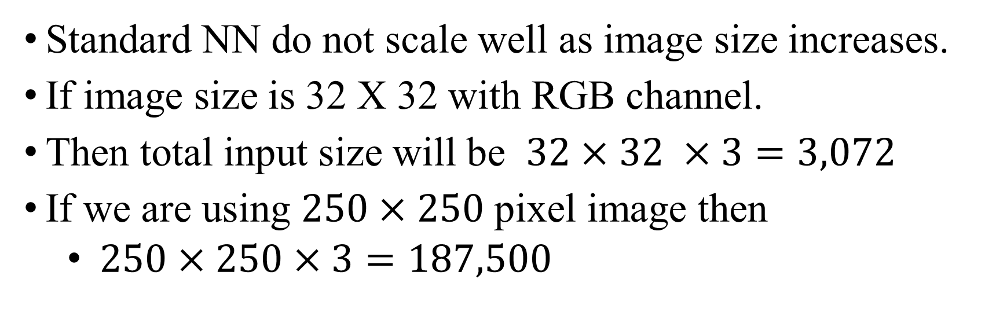
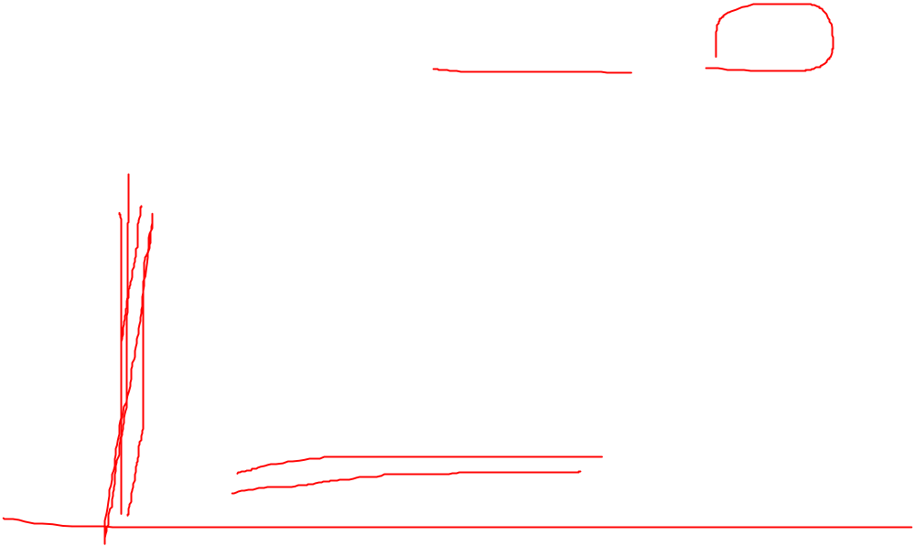
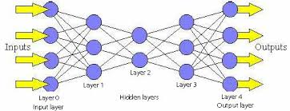

Slide 4
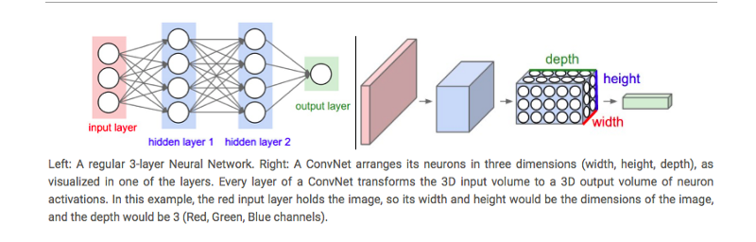
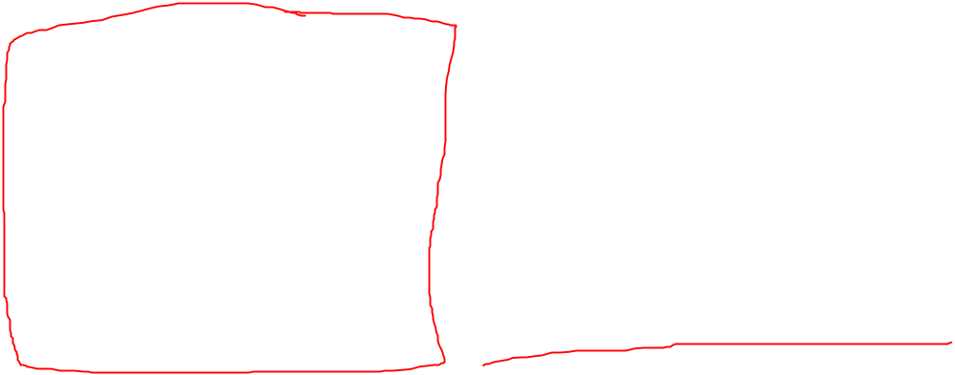

Slide 5
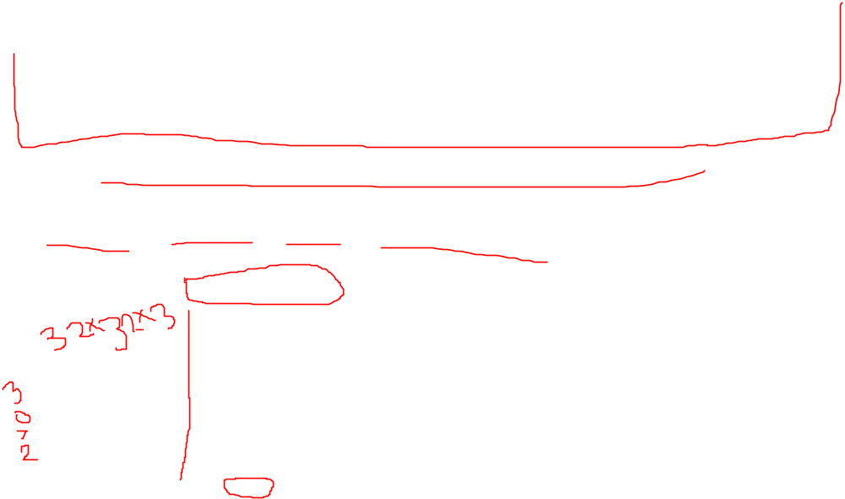
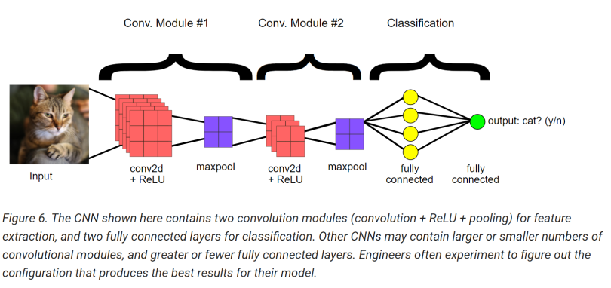
CNN Layer Types
Convolutional II. Activation (ACT or RELU)
III. Pooling (POOL) IV. Fully-Connected(FC)
Batch Normalization (BN) VI. Dropout (DO)
We often use simple text diagrams to describe a CNN: INPUT => CONV => RELU => FC => SOFTMAX

Slide 6
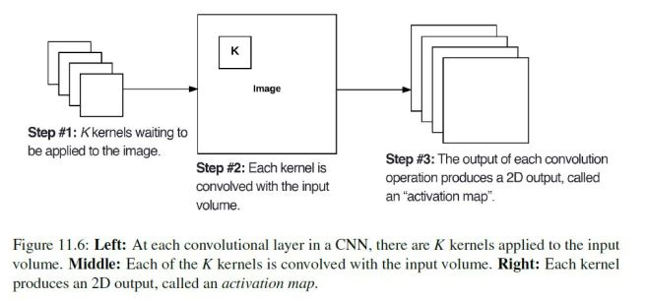
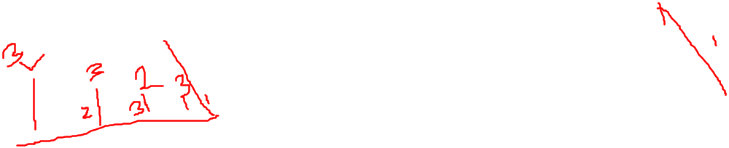
Convolutional Layer (CNOV)
Core building block of a CNN.
Its parameters consist of a set of K learnable filters(“kernels”)
Inputs to the CNN, the depth is the number of channels in the image. For volumes deeper in the network, the depth will be the number of filters applied in the previous layer.
Notes:
(i.e., a depth of three when working with RGB images, one for each channel)

Slide 7
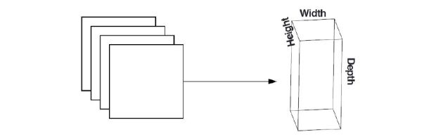
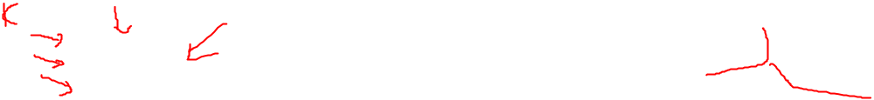

After applying all K filters to the input volume, we now have K, 2-dimensional activation maps.
Every entry in the output volume is an output of a neuron that “looks” at only a small region of the input.
Network “learns” filters that activate when they see a specific type of feature at a given spatial location in the input volume.

Slide 8
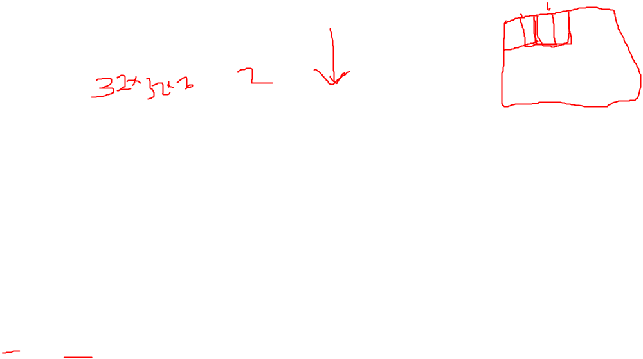
There are three parameters that control the size of an output volume:
  Depth,
  Stride, and
  Zero-padding size
Depth
  Controls the number of neurons (i.e., filters) in the CONV layer
  Each filter produces an activation map that “activates” in the presence of oriented edges or color.
Stride
  For each step, we create a new depth column around the local region of the image where we convolve each of the K filters with the region and store the output in a 3D volume.
  When creating our CONV layers we normally use a stride step size S of either S = 1 or S = 2.

Slide 9
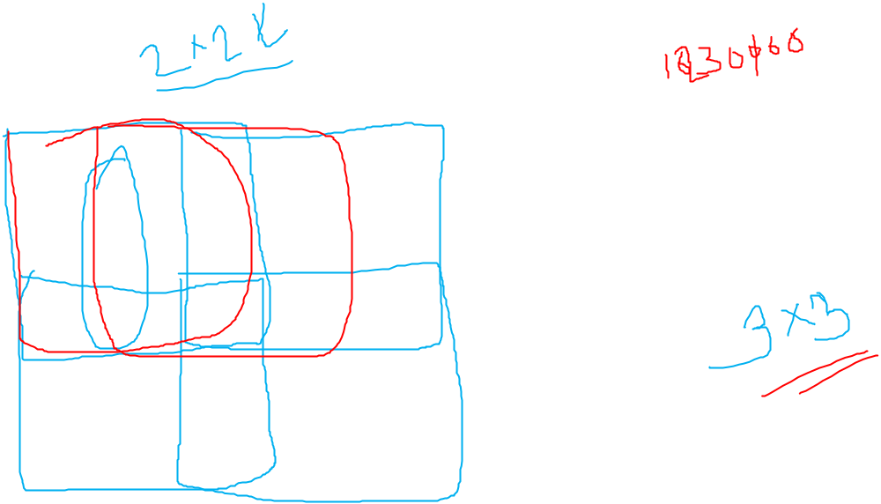
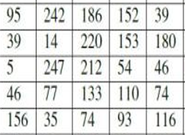
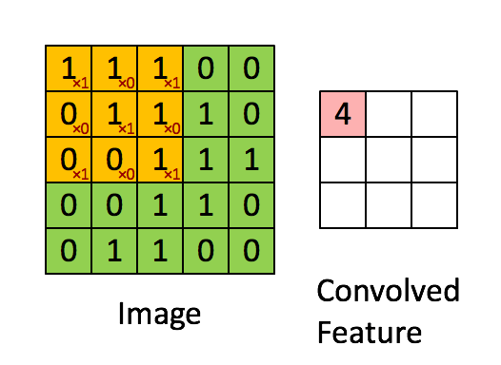
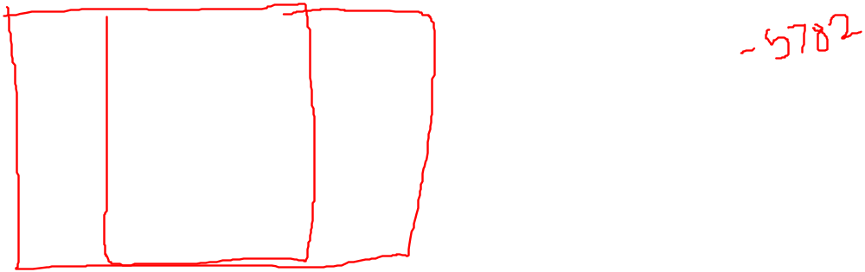
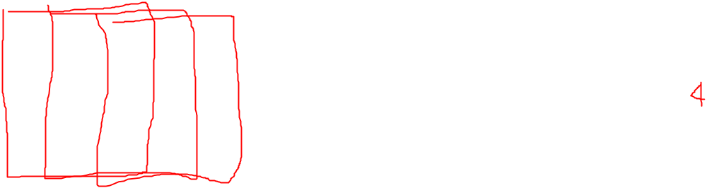
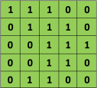
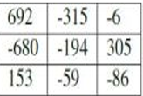

  Smaller strides will lead to overlapping receptive fields and larger output volumes. Conversely, larger strides will result in less overlapping receptive fields and smaller output volumes.

Slide 10
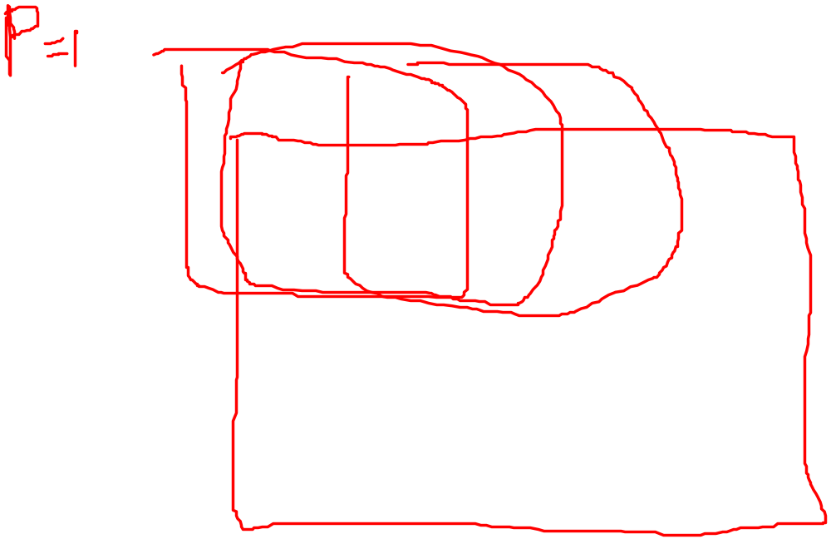
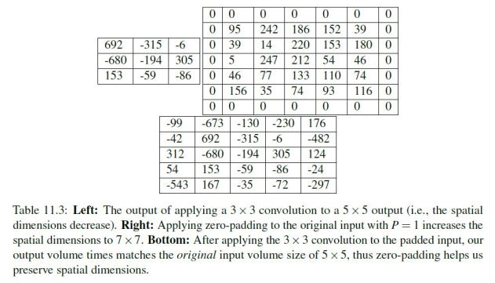
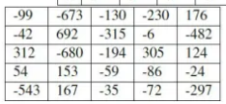
Zero Padding
  We can “pad” our input along the borders such that our output volume size matches our input volume size.
  The amount of padding we apply is controlled by the parameter P

Slide 11
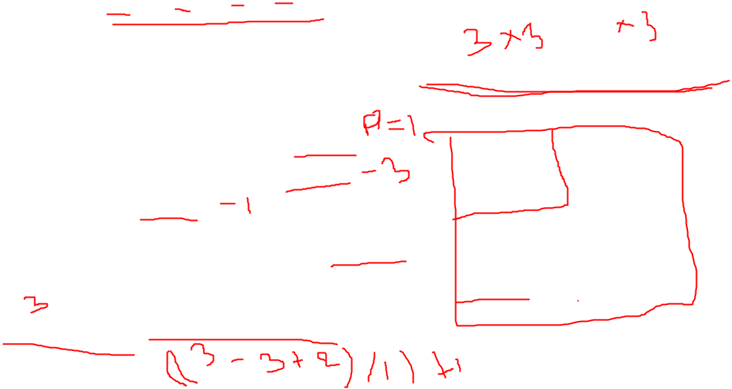
To construct a valid CONV layer, we need to ensure the following equation is an integer : ((W – F +2P) / S)+1
To summarize, the CONV layer :
  Accepts an input volume of size Winput x Hinput x Dinput
  Requires four parameters :
    The number of filters K.
    The receptive field size F.
    The stride S.
    The amount of zero-padding P.
The output of the CONV layer is then Woutput x Houtput x Doutput , where :
Woutput = ((Winput – F +2P) / S)+1
Houtput = ((Hinput – F +2P) / S)+1
Doutput = K

Slide 12
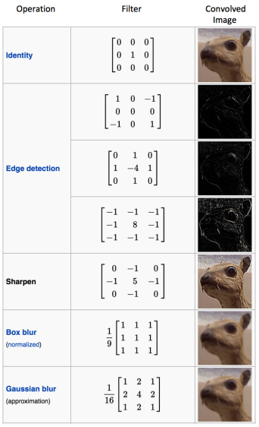

Slide 13
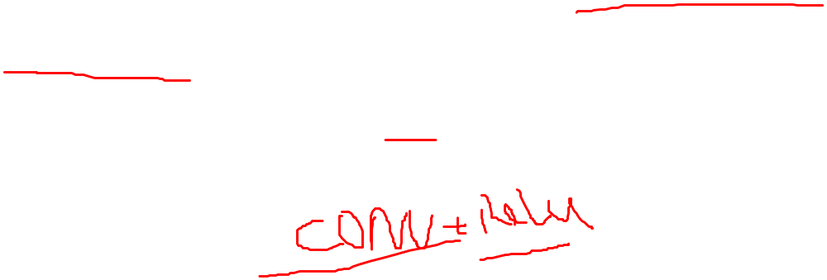
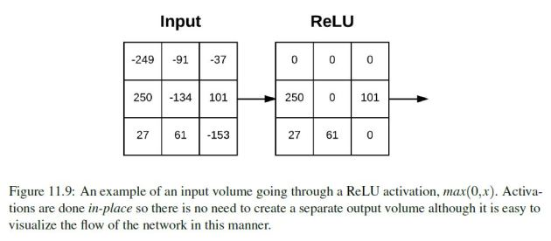
Activation Layer (ReLU)
After each CONV layer in a CNN, we apply a nonlinear activation function, such as ReLU, ELU, or any of the other Leaky ReLU variants
ReLU is an element wise operation (applied per pixel) and replace all negative pixel values in the feature map by zero.

Slide 14
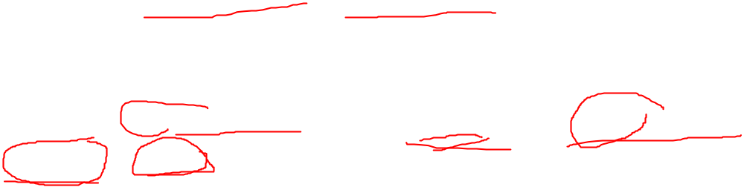
Pooling Layer (POOL)
Two methods to reduce the size of an input volume – CONV layers with a stride > 1 and POOL layers.
Common to insert POOL layers in-between consecutive CONV layers in a CNN architectures :
INPUT => CONV => RELU => POOL => CONV => RELU => POOL => FC
The primary function of the POOL layer is to progressively reduce the spatial size

Slide 15
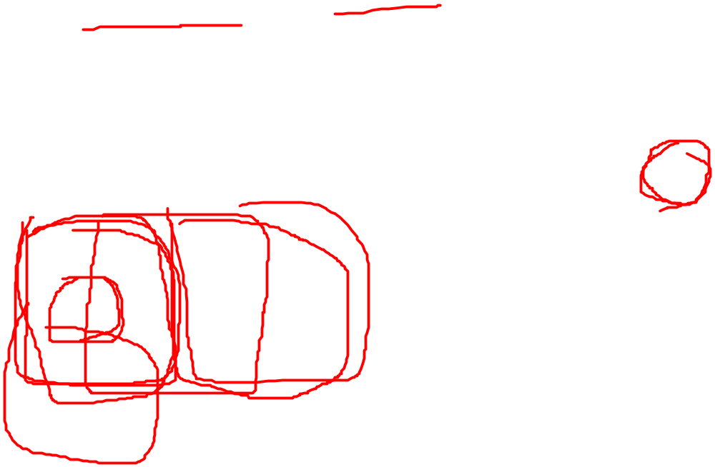
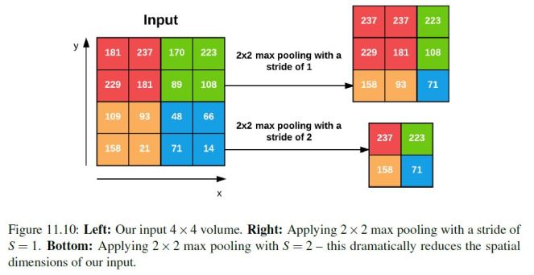
Max pooling is done in the middle of the CNN architecture to reduce spatial size,
Average pooling is normally used as the final layer of the network (e.x., GoogLeNet, SqueezeNet, ResNet) where we wish to avoid using FC layers entirely.

Slide 16
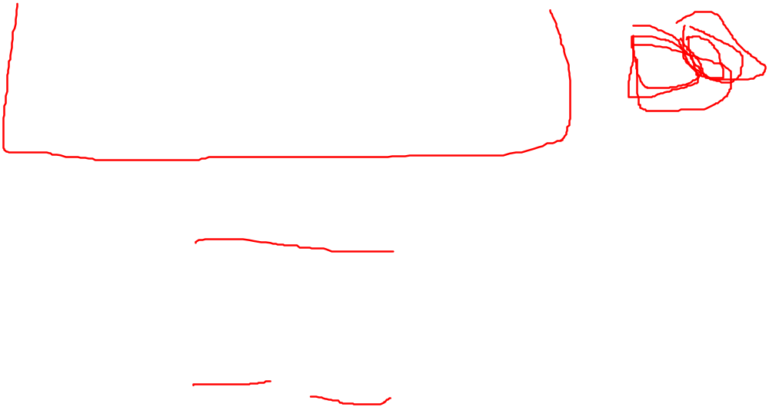
Applying the POOL operation yields an output volume of size Woutput x Houtput x Doutput , where :
  Woutput = ((Winput – F) / S)+1
  Houtput = ((Hinput – F) / S)+1
  Doutput = Dinput
In practice, we tend to see two types of max pooling variations :
  Type #1: F = 3, S = 2 which is called overlapping pooling and normally applied to images/input volumes with large spatial dimensions.
  Type #2: F = 2, S = 2 which is called non-overlapping pooling.

Slide 17
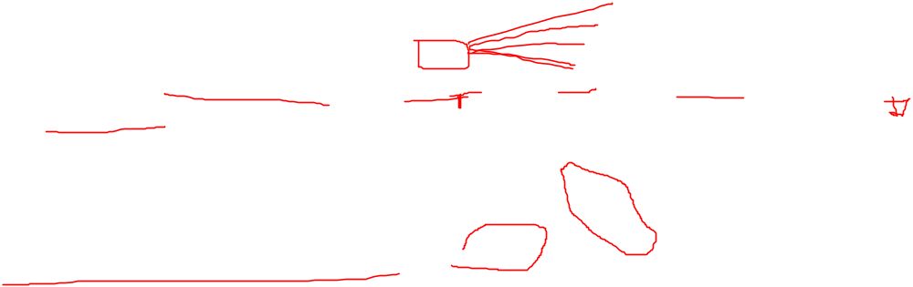
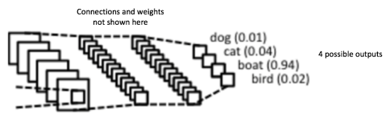
Fully Connected Layer (FC)
Neurons in FC layers are fully-connected to all activations in the previous layer, as is the standard for feedforward neural networks.
FC layers are always placed at the end of the network layer.
It’s common to use one or two FC layers prior to applying the softmax classifier, as the following (simplified) architecture demonstrates :
INPUT => CONV => RELU => POOL => CONV => RELU => POOL => FC => FC

Slide 18
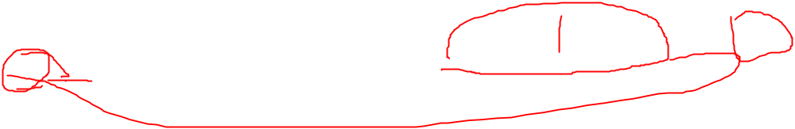
Dropout Layer (DO)
Dropout is actually a form of regularization that aims to help prevent over fitting by increasing testing accuracy, perhaps at the expense of training accuracy.
It is most common to place dropout layers with p = 0:5 in-between FC layers of an architecture where the final FC layer is assumed to be our softmax classifier :
… CONV => RELU => POOL => FC => DO => FC => DO => FC

Slide 19
